Slide 1

33
11
次の式の分母を有理化せよ。
$$\text{⑴ }\frac{1}{\sqrt{6}+\sqrt{2}}$$
$$\text{⑵ }\frac{\sqrt{3}}{\sqrt{5}−\sqrt{3}}$$
$$\text{⑶ }\frac{3}{\sqrt{7}+2}$$
$$\text{⑷ }\frac{\sqrt{2}}{1−\sqrt{2}}$$
$$\text{⑸ }\frac{\sqrt{7}+\sqrt{2}}{\sqrt{7}−\sqrt{2}}$$
$$\text{⑹ }\frac{\sqrt{3}−1}{\sqrt{3}+1}$$

Slide 2
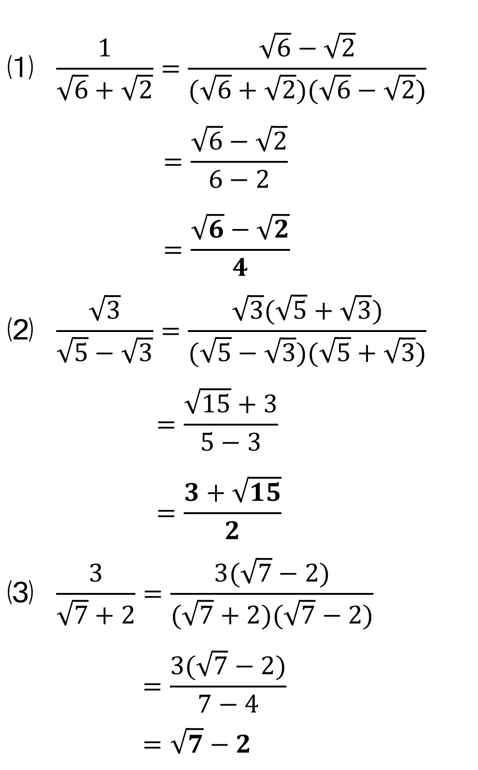
33
11
$$\text{⑴} \frac{1}{\sqrt{6}+\sqrt{2}}=\frac{\sqrt{6}−\sqrt{2}}{(\sqrt{6}+\sqrt{2})(\sqrt{6}−\sqrt{2})}$$
$$=\frac{\sqrt{6}−\sqrt{2}}{6−2}$$
$$=\frac{\sqrt{6}−\sqrt{2}}{4}$$
$$\text{⑵} \frac{\sqrt{3}}{\sqrt{5}−\sqrt{3}}=\frac{\sqrt{3}(\sqrt{5}+\sqrt{3})}{(\sqrt{5}−\sqrt{3})(\sqrt{5}+\sqrt{3})}$$
$$=\frac{\sqrt{15}+3}{5−3}$$
$$=\frac{3+\sqrt{15}}{2}$$
$$\text{⑶} \frac{3}{\sqrt{7}+2}=\frac{3(\sqrt{7}−2)}{(\sqrt{7}+2)(\sqrt{7}−2)}$$
$$=\frac{3(\sqrt{7}−2)}{7−4}$$
$$=\sqrt{7}−2$$

Slide 3
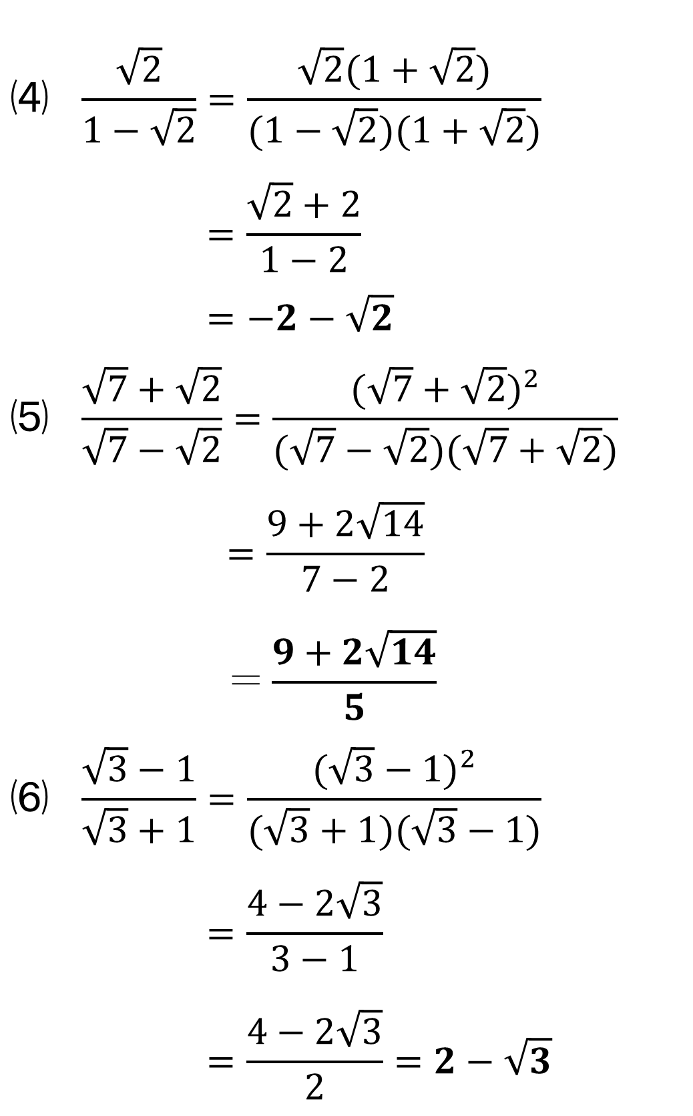
33
11
$$\text{⑷} \frac{\sqrt{2}}{1−\sqrt{2}}=\frac{\sqrt{2}(1+\sqrt{2})}{(1−\sqrt{2})(1+\sqrt{2})}$$
$$=\frac{\sqrt{2}+2}{1−2}$$
$$=−2−\sqrt{2}$$
$$\text{⑸} \frac{\sqrt{7}+\sqrt{2}}{\sqrt{7}−\sqrt{2}}=\frac{(\sqrt{7}+\sqrt{2})^{2}}{(\sqrt{7}−\sqrt{2})(\sqrt{7}+\sqrt{2})}$$
$$=\frac{9+2\sqrt{14}}{7−2}$$
$$＝\frac{9+2\sqrt{14}}{5}$$
$$\text{⑹} \frac{\sqrt{3}−1}{\sqrt{3}+1}=\frac{(\sqrt{3}−1)^{2}}{(\sqrt{3}+1)(\sqrt{3}−1)}$$
$$=\frac{4−2\sqrt{3}}{3−1}$$
$$=\frac{4−2\sqrt{3}}{2}=2−\sqrt{3}$$

