Slide 1

29
28
次の式を因数分解しなさい。
⑴ $3x^{2}+8x+5$
⑵ $5x^{2}+2x−3$
⑶ $2x^{2}−15x+7$
⑷ $6x^{2}−7x−3$

Slide 2

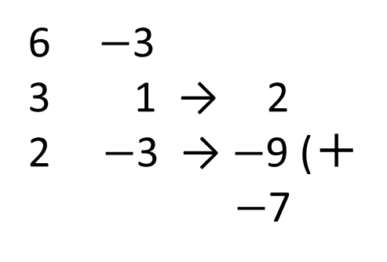


29
28
⑴ $3x^{2}+8x+5$
$$=\left(3x+5\right)\left(x+1\right)$$
⑵ $5x^{2}+2x−3$
$$=\left(5x−3\right)\left(x+1\right)$$
⑶ $2x^{2}−15x+7$
$$=\left(2x−1\right)\left(x−7\right)$$
⑷ $6x^{2}−7x−3$
$$=\left(3x+1\right)\left(2x−3\right)$$
3 5
3 5 → 5
1 1 → 3 (＋
8
5 $−$3
5 $−$3 → $−$3
1 1 → 5 (＋
2
2 7
2 $−$1 → $−$1
1 $−$7 → $−$14 (＋
$−$15
6 $−$3
3 1 → 2
2 $−$3 → $−$9 (＋
$−$7

